Slide 1
UNIT III
GREEDY METHOD
GENERAL METHOD
APPLICATIONS
3.1 KNAPSACK PROBLEM
3.2 JOB SEQUENCING WITH DEAD LINES
3.3 MINIMUM COST SPANNING TREES
3.4 PRIMS ALGORTIHM
3.5 KRUSKAL ALGORITHM
3.6 SINGLE SOURCE SHORTEST PATH PROBLEM

Slide 2
GREEDY METHOD
A candidate set − A solution is created from this set.
A selection function − Used to choose the best candidate to be added to the solution.
A feasibility function − Used to determine whether a candidate can be used to contribute to the solution.
An objective function − Used to assign a value to a solution or a partial solution.
A solution function − Used to indicate whether a complete solution has been reached.

Slide 3
GENERAL METHOD
Greedy(a,n) // a[1:n] contains the n inputs
{
solution= ϕ // Initialize solution
for i=1 to n do
{
x := Select(a);
if Feasible(solution , x) then
solution=Union(solution , x)
}
return solution;
}

Slide 4
APPLICATIONS- KNAPSACK PROBLEM
Given a set of items, each with a weight and a value, determine a subset of items to include in a collection so that the total weight is less than or equal to a given limit and the total value is as large as possible.
The knapsack problem is in combinatorial optimization problem. It appears as a sub-problem in many, more complex mathematical models of real-world problems.
From the problem statement
There are n items in the store
Weight of i_{th} item is w_{i} > 0
Profit of i_{th} item P_{i} > 0
Capacity of Knapsack is W

Slide 5
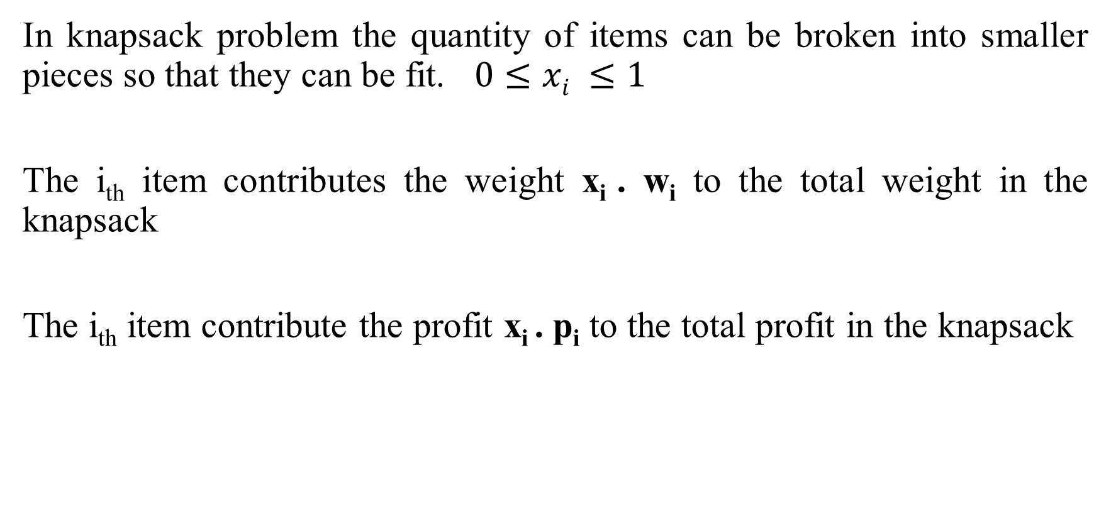
APPLICATIONS- KNAPSACK PROBLEM
In knapsack problem the quantity of items can be broken into smaller pieces so that they can be fit. $0≤xi ≤1$
The i_{th} item contributes the weight x_{i} . w_{i} to the total weight in the knapsack
The i_{th} item contribute the profit x_{i} . p_{i} to the total profit in the knapsack

Slide 6
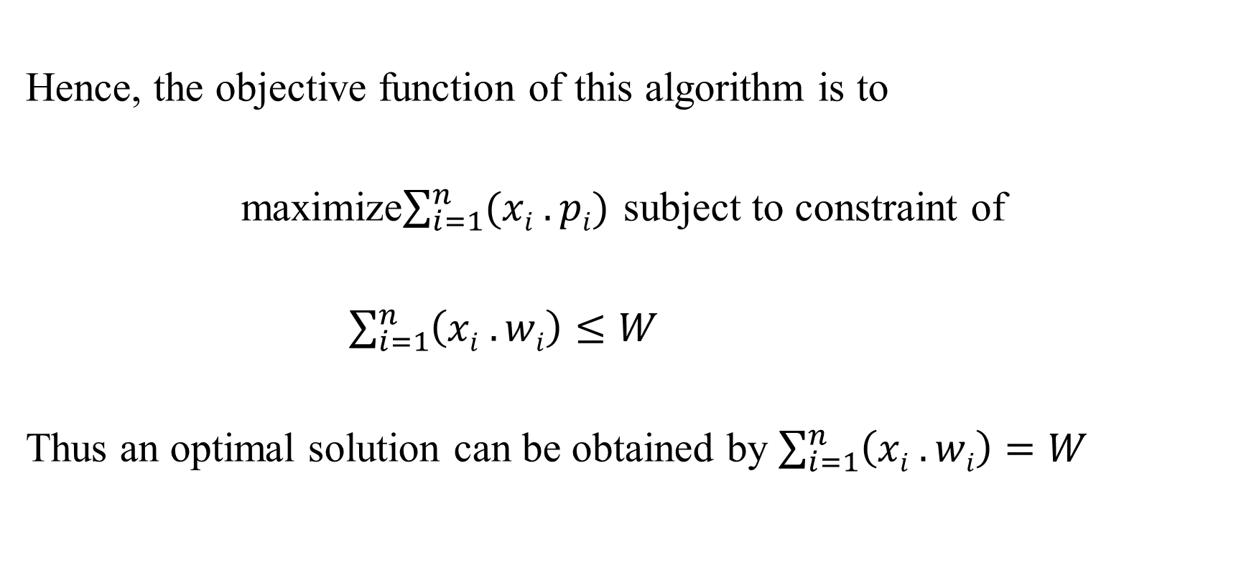
APPLICATIONS- KNAPSACK PROBLEM
Hence, the objective function of this algorithm is to
maximize$\sum_{i=1}^{n}{(xi . pi)}$ subject to constraint of
$\sum_{i=1}^{n}{\left(xi . wi\right)≤W}$
Thus an optimal solution can be obtained by $\sum_{i=1}^{n}{\left(xi . wi\right)=W}$

Slide 7
APPLICATIONS- KNAPSACK PROBLEM
Algorithm: Greedy-Fractional-Knapsack (w[1..n], p[1..n], W)
for i = 1 to n
do x[i] = 0
weight = 0
for i = 1 to n
if weight + w[i] ≤ W then
x[i] = 1
weight = weight + w[i]
else
x[i] = (W - weight) / w[i]
weight = W
break
return x

Slide 8
APPLICATIONS- KNAPSACK PROBLEM
If the provided items are already sorted into a decreasing order of P_{i}/w_{i}, then the while-loop takes a time of O(n), therefore the total time including sorting is O(n logn)

Slide 9
APPLICATION: JOB SEQUENCING WITH DEAD LINES
Problem Statement of Job Sequencing with deadlines:
The objective is to find a sequence of jobs, which is completed within deadlines and gives us maximum profit.
Let us consider, a set of n given jobs associated with deadlines and a profit is earned by a job, if the job is completed by its deadline.
The jobs need to be sequenced in such away that they need to earn maximum profit.
Myth: it may happen that all the given jobs may not be completed within their deadlines.

Slide 10
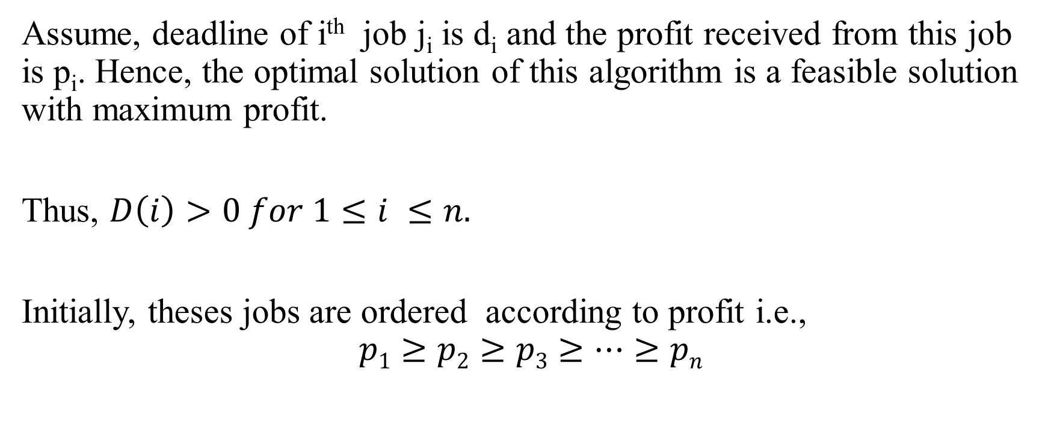
APPLICATION: JOB SEQUENCING WITH DEAD LINES
Assume, deadline of i^{th} job j_{i} is d_{i} and the profit received from this job is p_{i}. Hence, the optimal solution of this algorithm is a feasible solution with maximum profit.
Thus, $D\left(i\right)>0 for 1≤i ≤n.$
Initially, theses jobs are ordered according to profit i.e.,
$$p1≥p2≥p3≥…≥pn$$

Slide 11
APPLICATION: JOB SEQUENCING WITH DEAD LINES
Algorithm: Job-Sequencing-with-deadline (D,J,n,k)
D(0)=0, j(0)=0;
k=1;
j(1) = 1 // means first job selected
for i= 2 …. N do
r=k
while D(j( r)) > D(i) and D(j( r)) ≠ r do
r=r-1
If D(j(r)) ≤ D(i) and D(i) > r then
for l= k … r +1 by -1 do
j(l+1) = j(l)
J(r+1) = I
k=k+1

Slide 12

APPLICATION: JOB SEQUENCING WITH DEAD LINES
Analysis
In this Algorithm, we are using two loops one is within another Hence, the complexity of this algorithm is $O(n2)$

Slide 13
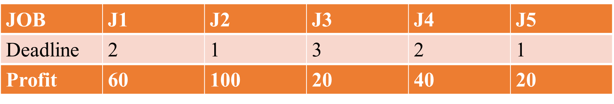
APPLICATION: JOB SEQUENCING WITH DEAD LINES
Solution: To Solve this Problem, the given jobs are sorted according to their profit in a descending order. Hence, after sorting, the jobs are ordered as shown in the following table. `

Slide 14
APPLICATION: JOB SEQUENCING WITH DEAD LINES
JOB | J2 | J1 | J4 | J3 | J5
Deadline | 1 | 2 | 2 | 3 | 1
Profit | 100 | 60 | 40 | 20 | 20
from the set of jobs, first we select J₂, as it can be completed within its deadline and contributes maximum profit.
Next J₁ is selected as it gives more profit compared to J_{5.}
In the next clock, J₅, cannot be selected as its deadline is over, hence J₁ is selected as it executes within its deadline.
Thus the solution is the sequence of jobs (J₂,J₁,J₃) which are being executed within their deadline and gives maximum profit.
Total Profit of this sequence is 100+60+20= 180.

Slide 15
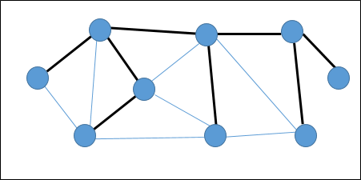
MINIMUM SPANNING TREE
Spanning tree : A Spanning tree is a subset of an undirected graph that has all the vertices connected by minimum number of edges.
If all the vertices are connected in a graph, there exists at least one spanning tree.
In a graph, there may exist more than one spanning tree.
Properties
A Spanning tree does not have any cycle.
Any vertex can be reached from any other vertex.

Slide 16
MINIMUM SPANNING TREE
One graph may have more than one spanning tree. If there are n number of vertices, the spanning tree should have n-1 number of edges.
Hence, if each of the graph is associated with a weight and there exists more than one spanning tree, we need to find the minimum spanning tree of the graph.
If there exist any duplicate weighted edges, the graph may have multiple minimum spanning tree.
MINIMAL SPANNING TREE: A Minimum Spanning Tree (MST) is a subset of edges of a connected weight undirected graph that connects all the vertices together with the minimum possible total edge weight.

Slide 17
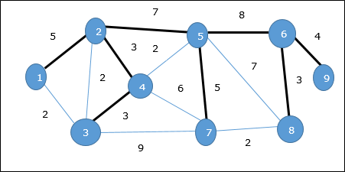
SPANNING TREE
In the given graph the spanning tree is represented shown
From the graph the spanning tree is
(5+3+3+7+5+8+3+4) = 38

Slide 18
PRIMS ALGORTIHM
It is a greedy approach to find the minimum spanning tree (MST)
A Minimum spanning tree computation can be started from arbitrary vertex. Let us consider the following undirected graph for constructing MST.
7
8
2
5
6
3
4
5
5
7
9
1
2
4
5
3
5
2
3
8
3
7
9
2

Slide 19
PRIMS ALGORTIHM
Let the arbitrary vertex be 1 the options of choosing next vertex are (1,2)=5; (1,3)=2 hence choose the pair of vertices with minimum weight i.e., (1,3)
7
8
2
5
6
3
4
5
2
7
2
9
1
4
5
3
5
2
3
8
3
7
9
2

Slide 20
PRIMS ALGORITHM
Algorithm: MST-Prim’s (G, w, r)
for each u є G.V
u.key = ∞
u.∏ = NIL
r.key = 0
Q = G.V
while Q ≠ Ф
u = Extract-Min (Q)
for each v є G.adj[u]
if each v є Q and w(u, v) < v.key
v.∏ = u v.
key = w(u, v)
The function Extract-Min returns the vertex with minimum edge cost.

Slide 21

PRIMS ALGORTIHM-time complexity
The Minimum weights choosen to form a MST in the undirected graph represent a heap structure.
As the time complexity required for computing the heap is $\left(o(n)\right)$
The total space complexity of order $\left(O(V+E)\right)$

Slide 22
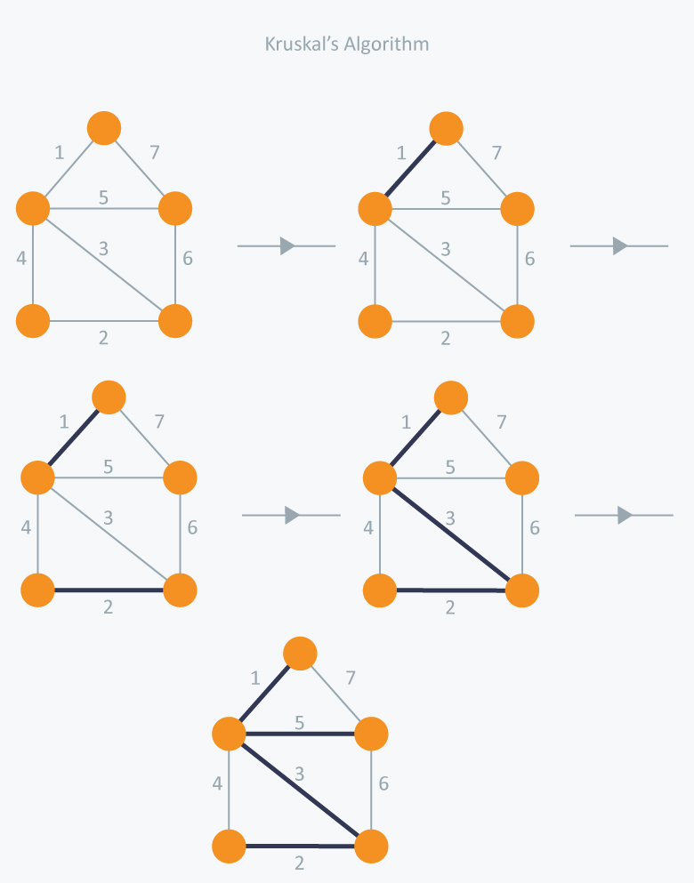
KRUSKALS ALGORITHM
In Kruskal’s algorithm, at each iteration we will select the edge with the lowest weight. So, we will start with the lowest weighted edge first i.e., the edges with weight 1.
After that we will select the second lowest weighted edge i.e., edge with weight 2. Notice these two edges are totally disjoint.
Now, the next edge will be the third lowest weighted edge i.e., edge with weight 3, which connects the two disjoint pieces of the graph. Now, we are not allowed to pick the edge with weight 4, that will create a cycle.
So we will select the fifth lowest weighted edge i.e., edge with weight 5.
Now the other two edges will create cycles so we will ignore them. In the end, we end up with a minimum spanning tree with
total cost 11 ( = 1 + 2 + 3 + 5).

Slide 23
KRUSKALS ALGORITHM
MST- KRUSKAL (G, w)
1.A ← ∅
2. for each vertex v ∈ V [G]
3. do MAKE - SET (v)
4. sort the edges of E into non decreasing order by weight w
5. for each edge (u, v) ∈ E, taken in non decreasing order by weight
6. do if FIND-SET (μ) ≠ if FIND-SET (v)
7. then A ← A ∪ {(u, v)}
8. UNION (u, v)
9. return A

Slide 24
KRUSKALS ALGORITHM
Analysis
Where E is the number of edges in the graph and V is the number of vertices, Kruskal's Algorithm can be shown to run in O (E log E) time, or simply, O (E log V) time, all with simple data structures. These running times are equivalent because:
E is at most V² and log V²= 2 x log V is O (log V).
If we ignore isolated vertices, which will each their components of the minimum spanning tree, V ≤ 2 E, so log V is O (log E).
Thus the total time is
O (E log E) = O (E log V).

Slide 25
DIFFERENCE BETWEEN PRIMS ALGORITHM AND KRUSKALS ALGORITHM
The basic difference is in which edge you choose to add next to the spanning tree in each step.
In Prim's Algorithm we hold the phenomenon of connected component, starting with a single vertex. lookig at all edges from the current component to other vertices and find the smallest among them. Subsequently add the neighboring vertex to the component, increasing its size by 1. In N-1 steps, every vertex would be merged to the current one if we have a connected graph.
In Kruskal's algorithm we do not hold the phenomenon of connected component but imply the phenomenon of a forest. At each stage, of the whole graph the smallest edge that does not create a cycle in the current forest is identified, Such an edge has to necessarily merge two trees in the current forest into one. As N single-vertex tree is considered first , in N-1 steps, they would all have merged into one if the graph was connected.

Slide 26
SINGLE SOURCE SHORTEST PATHS
Given a graph G and source vertex v in the graph, find the shortest paths from the source to all vertices in the given graph.
An algorithm designed by Dijkstra is named after it as Dijkstra algorithm. This algorithm is very similar to Prim’s algorithm for spanning tree
In Dijkstra’s algorithm a Shortest Path Tree (SPT) is generated with a given source root.
In this approach two sets are maintained one indicating the vertices included in the shortest path; in the other set the vertices not yet included in the shortest path.
If the given graph is not directed but assigned with edge values create a parallel path.

Slide 27
SINGLE SOURCE SHORTEST PATH
Pick a vertex u which is not there is sptset and has a minimum distance value
Include u to sptset
Update distance value of all adjacent vertices of u, to update the distance values, iterate through all adjacent vertices.
For every adjacent vertex v,
if the sum of distance value of u (from source) and weight of edge u-v, is less than the distance value of v, then
update the distance value of v.

Slide 28
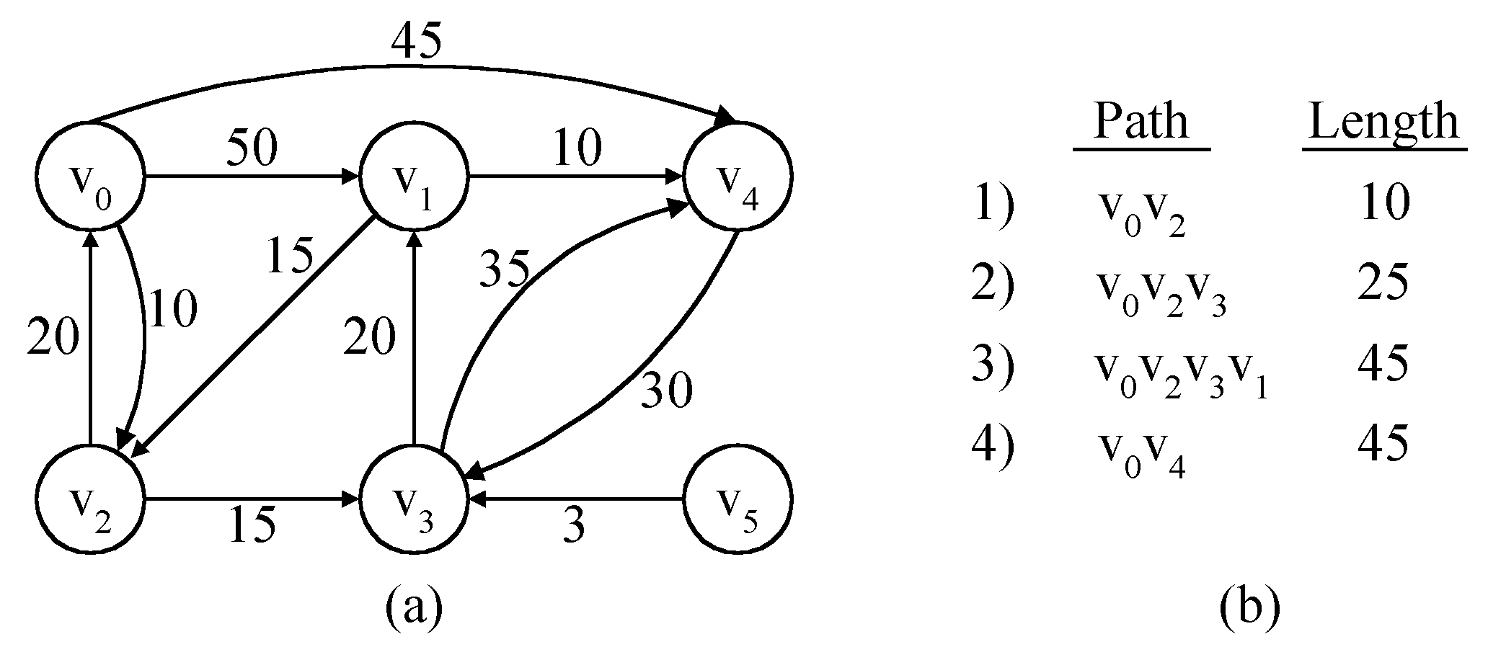
The Single-Source Shortest path Problem ( SSSP)
Given a positively weighted directed graph G with a source vertex v₁, find the shortest paths from v₁ to all other vertices in the graph.
Ex :-
v
V₁
V₂
V₅
V₁V₃
V₁V₃V₄
V₁V₃V₄V₂
V₃
V₄
V₆
V₁V₅
5) V₁V₃V₄V₆ 28

Slide 29
45
1
50
2
10
5
15
35
10
20
20
30
3
15
4
3
6
Iteration | S | Dist[2] | Dist[3] | Dist[4] | Dist[5] | Dist[6] | Path | Length
Initial | {1} | 50 | 10 | ∞ | 45 | ∞ | --- | ---
✓
1 { 1,3 } 50 10 25 45 ∞ V₁,V₃ 10
✓
2 { 1,3,4 } 45 10 25 45 28 V₁,V₃,V₄ 25
✓
3 { 1,3,4,6 } 45 10 25 45 28 V₁,V₃,V_{4,}V₆ 28
✓
4 { 1,3,4,5,6 } 45 10 25 45 28 V₁,V₅ 45
✓
5 { 1,2,3,4,5,6 } 45 10 25 45 28 V₁,V₃,V_{4,}V ₂ 45

Slide 30
SSSP-Dijkstra’s algorithm
Dijkstra’s algorithm assumes that there exist a cost(e)for each e in the graph.
Maintains a set S of vertices whose SP from v ( source) has been determined.
a) Select the next minimum distance node u, which is not in S.
b) for each node w adjacent to u do
if( dist[w]>dist[u]+cost[u,w]) ) then
dist[w]:=dist[u]+cost[u,w];
Repeat step (a) and (b) until S=n (number of vertices).

Slide 31
Greedy algorithm to generate shortest paths
Algorithm ShortestPaths(v, cost, dist, n)
//dist[j], 1≤ j≤ n, is set to the length of the shortest path from vertex v to
// vertex j in a digraph G with n vertices. dist[v] is set to zero.
// G is represented by its cost adjacency matrix cost[1:n, 1:n].
{
for i := 1 to n do
{ // Initialize S.
s[i] := false; dist[i] := cost[v,i];
}
s[v] := true; // put v in S.
dist[v] := 0.0 ;

Slide 32
for num: = 2 to n do
{ // Determine n-1 paths from v.
Choose u from among those vertices not in S such that dist[u] is minimum;
s[u] := true; // Put u in S.
for ( each w adjacent to u with S[w]= false) do
// Update distance
if( dist[w] > dist[u] + cost[u, w]) ) then
dist[w] := dist[u] + cost[u, w];
}
}
32

Slide 33
Time complexity of Dijkstra’s Algorithm
The for loop of line 7 takes o(n).
The for loop of line 12 takes o(n).
Each execution of this loop requires o(n) time at lines 15 and 18.
So the total time for this loop is o(n²).
Therefore, total time taken by this algorithm is o(n²).
33

Slide 34
SINGLE SOURCE SHORTEST PATHS
Analysis:
The given graph G is represented as an adjacency list.
Priority queue Q is represented as a binary heap.
Here, with adjacency list representation, all vertices of the graph can be traversed using BFS in O(V+E) time.
In min heap, operations like extract-min and decrease-key value takes O(logV) time.
So, overall time complexity becomes O(E+V) x O(logV) which is O((E + V) x logV) = O(ElogV)
This time complexity can be reduced to O(E+VlogV) using Fibonacci heap.

